Slide 1

Call Center Investigation

Slide 2



Agenda:
Understanding the Problem
  Data Scrubbing
  Data Description
  Summary of Insights
Modelling the Problem
  Forecast Preparation
  Time Series Decomposition
  Time Series Forecast
  Exploring the Impact on Headcount (FTE)
Solutions to the Problem
  Options Available
  Cost per Option
  Recommendations

Slide 3
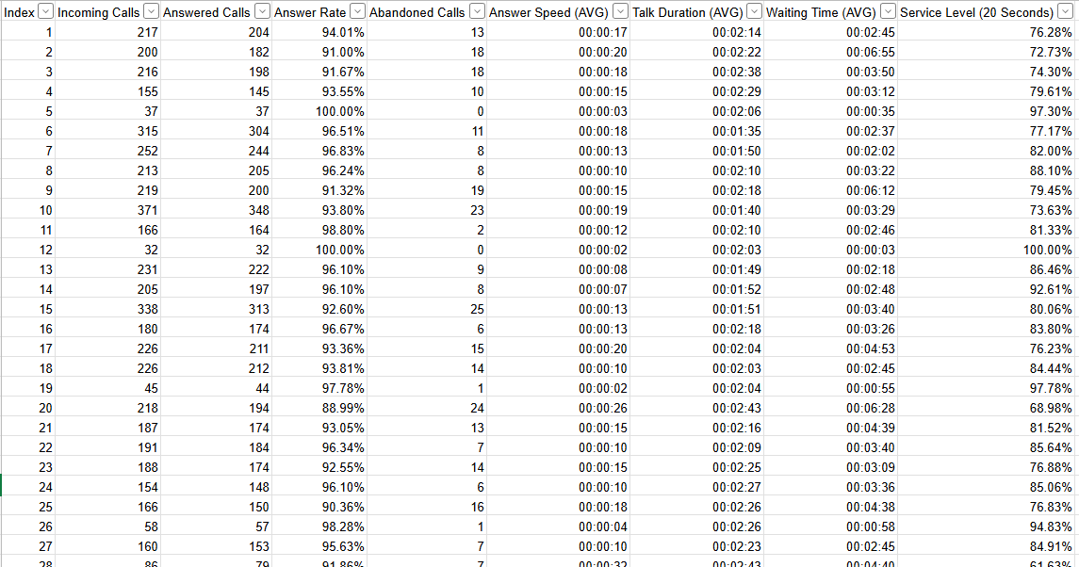
Data Description – Raw Data
Initial Inspection:
Data provides key call center metrics.
Index is column is used to put the data in sequence.
Kaggle Link: https://www.kaggle.com/datasets/satvicoder/call-center-data

Slide 4
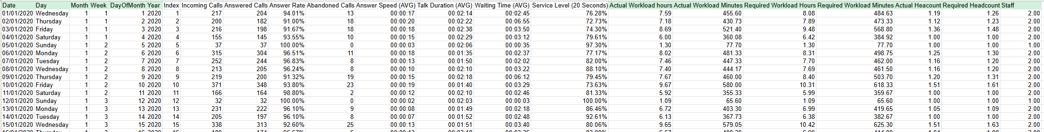
Data Description – Enriched Data
Enrich data with the following calculated fields:
Date | Calendar date taking 1 January as the start date.
Day of Week | Day of the week based on incoming call volume pattern per day.
Month | Month based on date.
Week | Week of the year in integer format
Day of Month | Day of the month in integer format
Actual Workload Hours | Average Talk Duration x Answered Calls
Actual Workload Minutes | Actual Workload Hours x 60 minutes
Required Workload Hours | Average Talk Duration x Incoming Calls
Required Workload Minutes | Required Workload Hours x 60 minutes
Actual Headcount | Actual workload minutes / 384
Required Headcount | Required Workload Minutes / 384
Staff | Minimum one staff per day, otherwise rounded up for Actual Headcount
Calendar date obtained by assuming January 1 start date and finding the closest January 1st Wednesday after posting of the data set.

Slide 5
Seasonal Patterns
Weekly
Monthly
Insights from initial pattern analysis:
Weekly pattern with reduced call volume on Sunday.
Monthly pattern shows no clear month end spikes in volume.
Yearly pattern shows no clear spikes in demand at any predictable points.
Key Observation: There is a large spike in April 2022, this signals potential external shock resulting in large volumes of calls.
Yearly

Slide 6
April Demand
Demand Spike
April 2022 has a large spike in daily calls (demand) which needs to be addressed before forecasting.

Slide 7
FTE Considerations
Headcount (FTE) is shown with a large spike in required staff from March to July of 2022.
Impact of Demand Spike

Slide 8
Data Description Insights
One to two agents at call center, with a potential part time agent.
Industry standard work day of a hours with 80% occupancy results in 384 workload minutes per day.
Work week from Monday to Sunday.
Sunday has limited work time creating a cyclical pattern for weeks.
Monthly or yearly cyclical pattern not evident.
Complete records until May 2023.
External event creating increased demand in the first half of 2022.

Slide 9
Agenda:
Understanding the Problem
  Data Scrubbing
  Data Description
  Summary of Insights
Modelling the Problem
  Forecast Preparation
  Time Series Decomposition
  Time Series Forecast
  Exploring the Impact on Headcount (FTE)
Solutions to the Problem
  Options Available
  Cost per Option
  Recommendations

Slide 10
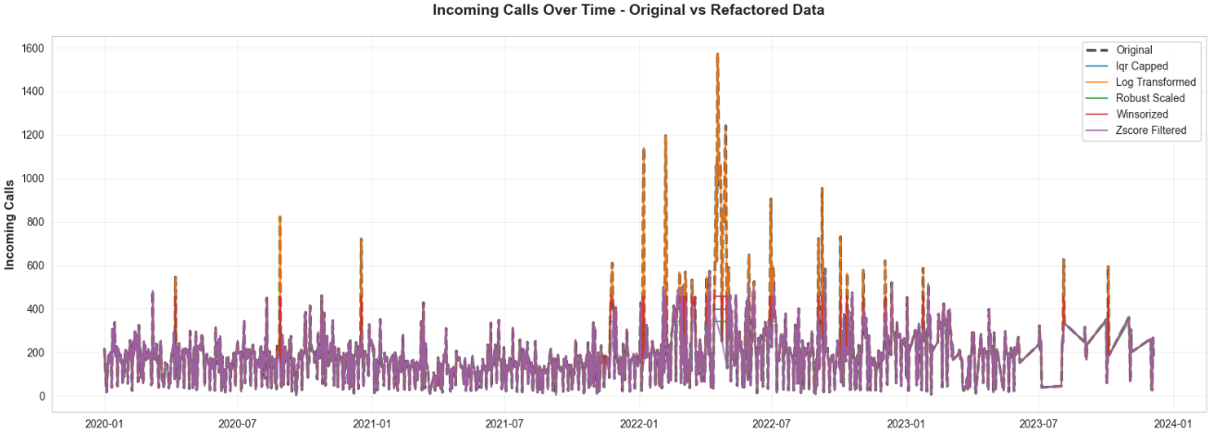
Forecasting Preparation
Data refactored to reduce the impact of outliers.
Z-score (purple line) refactoring used as it fit the actual data the best.
Certain transformations still had major outliers present.

Slide 11
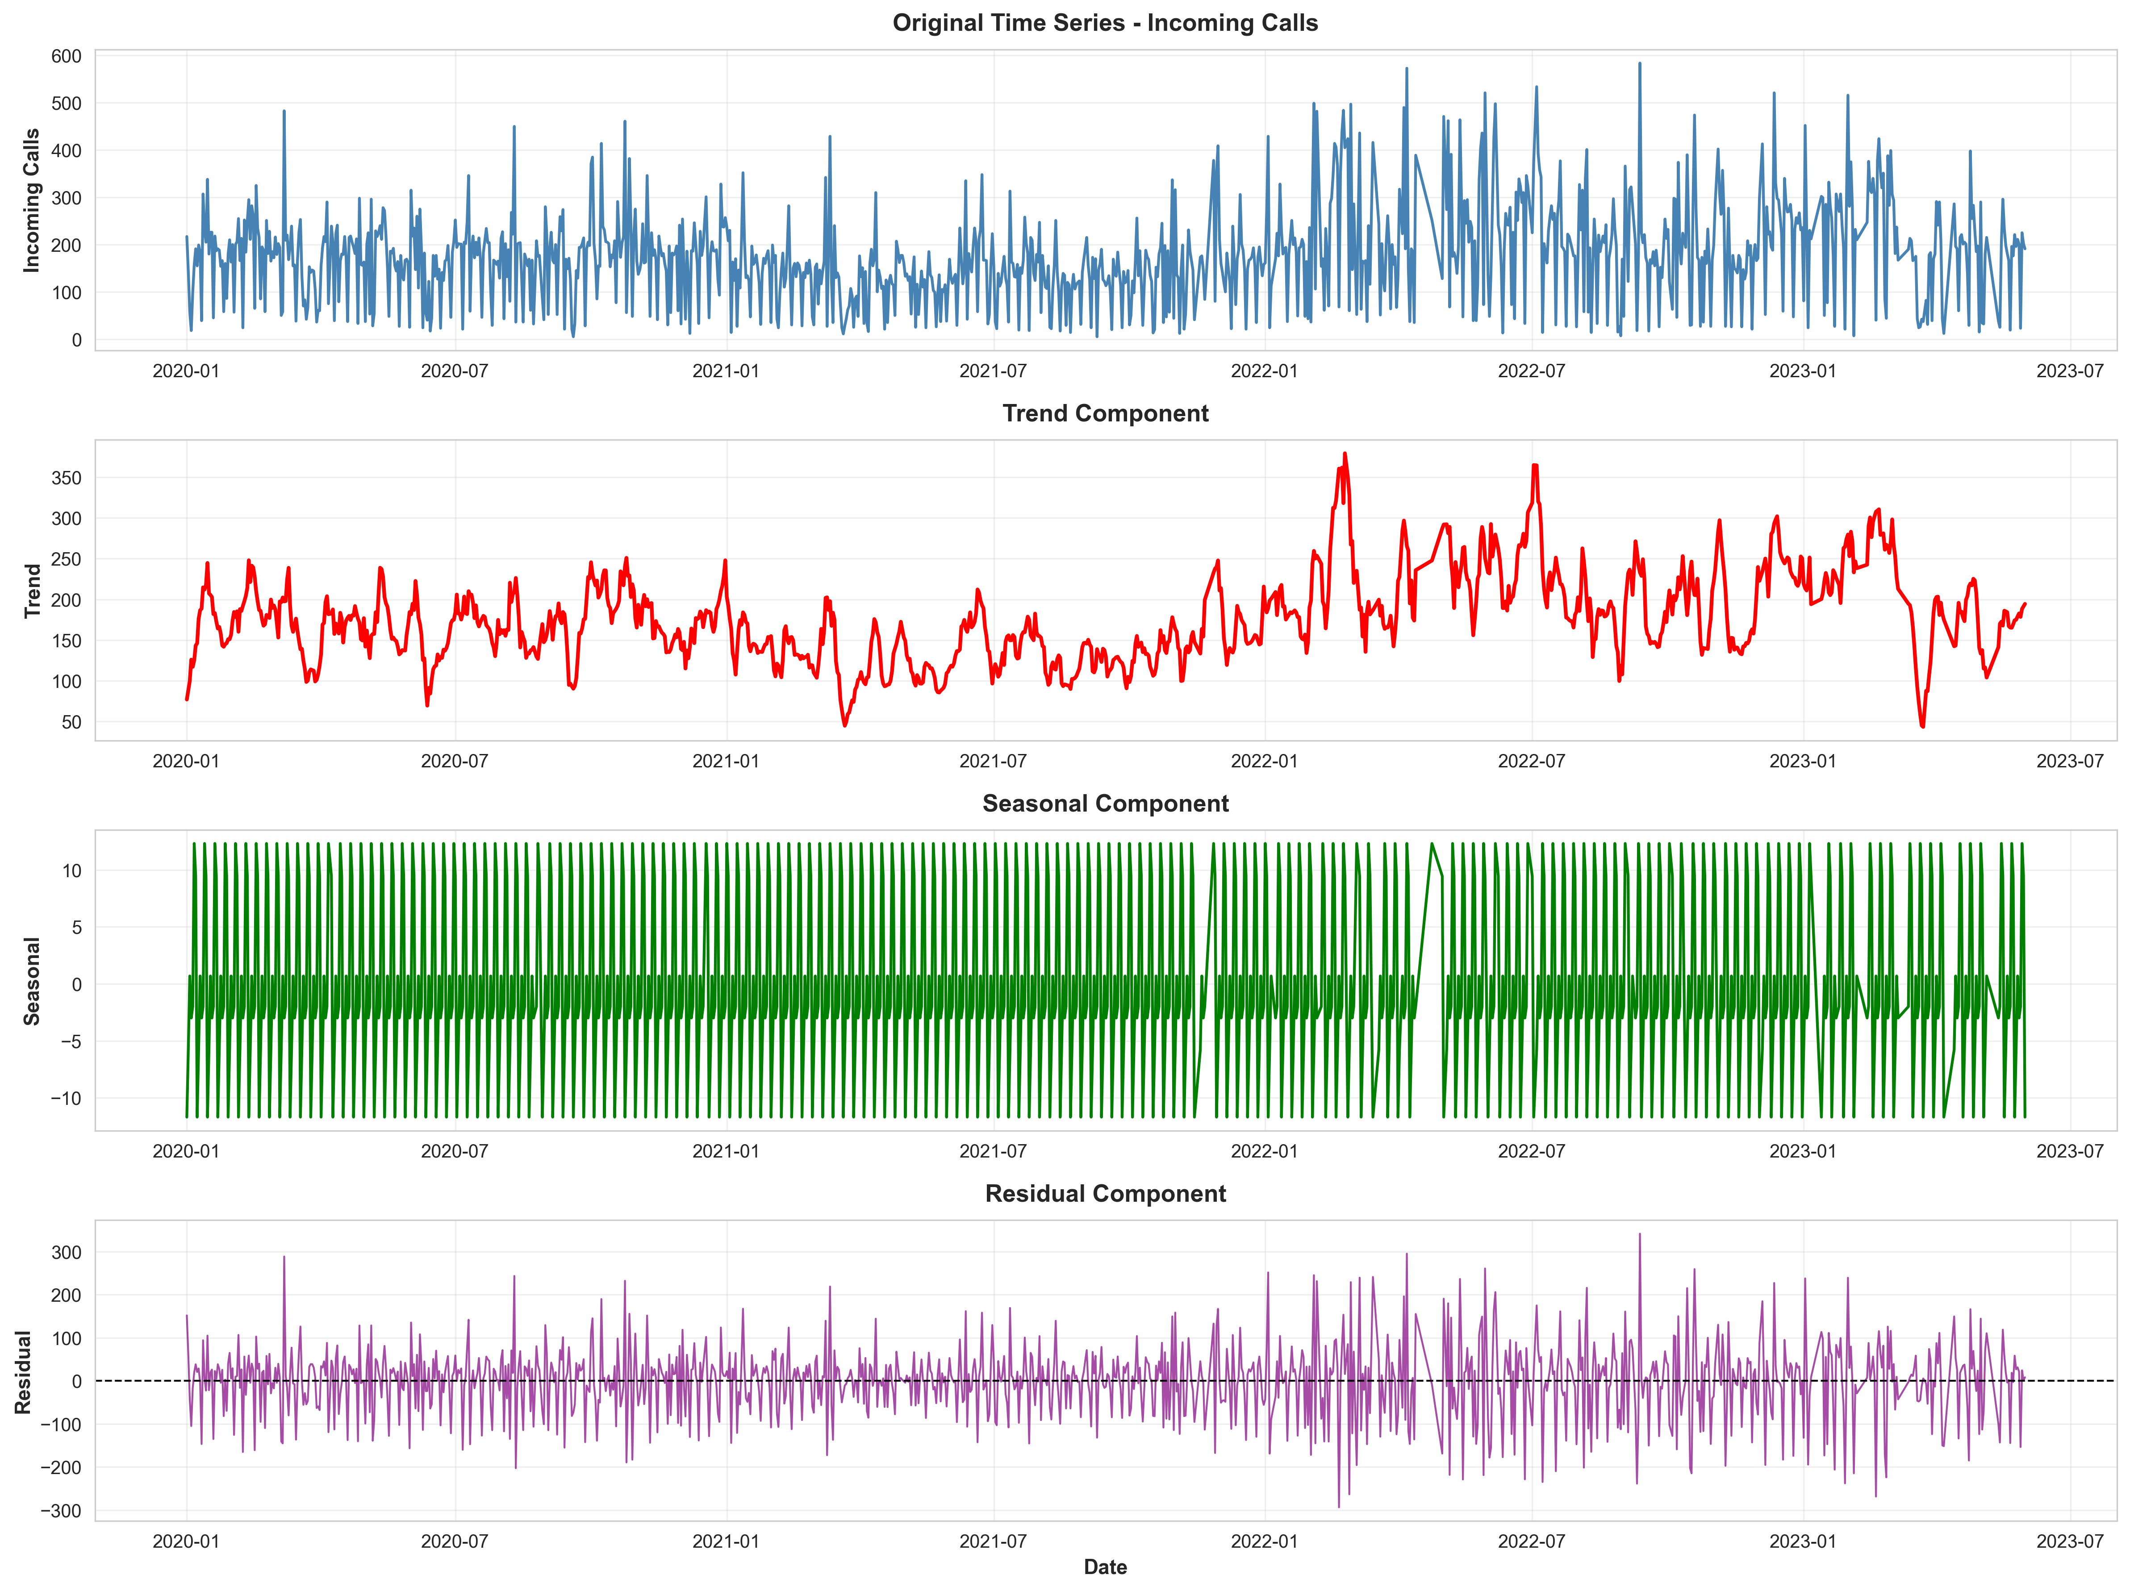
Time Series Decomposition
Time series decomposition yields a trend component beginning in 2021.
Clear seasonal component which is produced by weekly demand.
Residual component shows data is stationary and can be used for forecasting.
Trend Component Identified
Seasonal Component Identified
Stationary Data Identified

Slide 12
Time Series Forecast
Below shows the call volume forecast against the acutal volumes.
Forecast was done with the prophet aggregative algorithm.
Forecast fits the trend line well.

Slide 13
Exploring the Impact on Headcount (FTE)
The weekly headcount requirement is shown below.
There is a general need to have at least two agents at the call center, frequently requiring 3 agents in 2023.
There is a need to increase the number of call center agents in 2024.

Slide 14
Data Forecast Insights
Data required intervention to reduce the impact of outliers.
The refactored data was modelled using the additive non-linear Prophet package used for seasonal time series forecasting.
The package produced a well fitting forecast which can be used to model headcount.
Forecasted headcount shows that in most weeks 2 call center agents can manage the workload; however, the need for 3 agents will increase over time.
The decomposition yielded a partial trend with a strong weekly cycle as a seasonal pattern.

Slide 15
Agenda:
Understanding the Problem
  Data Scrubbing
  Data Description
  Summary of Insights
Modelling the Problem
  Forecast Preparation
  Time Series Decomposition
  Time Series Forecast
  Exploring the Impact on Headcount (FTE)
Solutions to the Problem
  Options Available
  Cost per Option
  Recommendations

Slide 16


Options Available
Threats to the Call Center.
  Spikes in demand due to external shocks.
  Small size of call center reduces its ability to absorb variability in demand.
  Continued increase in demand over the years requiring more agents for base demand in 2024.
Opportunities to limit impact of threats:
  Keep a larger call center on retainer that can be called on when external shocks happen.
  Hire additional agents in 2024.
  Implement a multi skilled employee model that can have other employees join the call center during peak periods and periods of external shocks.
  Consider hiring a manager to help manage the call center.
  Implement a chatbot/FAQ operator that can deal with low workload queries.
  Ensure there is a focus on first call resolution.

Slide 17
Cost per Option
Base Line Cost
Impact of Adding One More Staff Member
Scenario One: | Permanent Staff Only
Setup: | Year | Total Number: | Yearly Cost:
2 Permananent Staff | 2023 | 2 | € 100,000
2 Permanent Staff | 2024 | 2 | € 100,000
 |  | 2024 Total | € 100,000
Scenario Two: | Increase Permanent Staff
Setup: | Year | Total Number: | Yearly Cost:
2 Permananent Staff | 2023 | 2 | € 100,000
3 Permanent Staff | 2024 | 3 | € 150,000
 |  | 2024 Total | € 150,000
Impact of Retainer Call Center
Impact of ChatBot/FAQ
Scenario Three: | Permanent Staff Only and Call Center Retainer
Setup: | Year | Total Number: | Yearly Cost:
2 Permananent Staff | 2023 | 2 | € 100,000
2 Permananent Staff | 2024 | 2 | € 100,000
Retainer Fee | 2024 | 12 (€1000 per month) | € 12,000
Overflow Transfer Cost | 2024 | 5 (overflow events) | € 12,500
 |  | 2024 Total | € 124,500
Scenario Four: | Permanent Staff and Chat Agent/FAQ
Setup: | Year | Total Number: | Yearly Cost:
2 Permananent Staff | 2023 | 2 | € 100,000
Development costs | 2023 | 3 Part-Time Developers | € 60,000
2 Permananent Staff | 2024 | 2 | € 100,000
 |  | 2024 Total | € 100,000
All costs are demonstrative

Slide 18


Recommendations
What is the company priority?:
  Client satisfaction? - (Ability to handle all calls within SLA)
  Staff working conditions? - (Ensuring agents are not overworked)
  Cost reduction? - (Ensuring costs stay low)
Actions​
Increase the number of agents to 3 and put a call center on retainer.​
Implement a quarterly strategic planning review which revises the forecast and its requirement in thefuture. ​

Slide 19
Conclusion:
Understanding the Problem
  Data Scrubbing
  Data Description
  Summary of Insights
Modelling the Problem
  Forecast Preparation
  Time Series Decomposition
  Time Series Forecast
  Exploring the Impact on FTE
Solutions to the Problem
  Options Available
  Cost per Option
  Recommendations
Understood the Problem
  Data Enriched
  Data Analysed
  Problem Descsribed
Modelled the Problem
  Outliers Removed
  Time Series Decomposed
  Time Series Forecasted
  Head Count Evaluated
Solved to the Problem
  Solutions Proposed
  Costs Analysed
  Recommendation Given
If I were the COO, I would increase the number of agents to 3 and put a call center on retainer.

Slide 20
Questions?

